Slide 1
AWS Architecture Performance for Redshift Prediction
Pratham Choksi and Dae Hwang

Slide 2
Introduction/Objective
Our main focus for this project was to optimize cost and time. We performed various experiments to find the best partition, data and batch size that provided the best throughput to cost ratio.
How much processing time can I buy with a small amount of money?

Slide 3
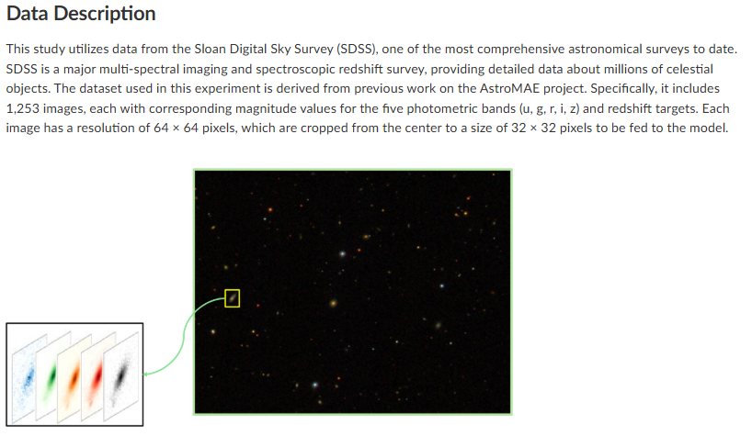
Data Preprocessing
Our data is images of galaxies, stars and quasars.
Our main goal is to predict the Redshift
The data was stored in PyTorch file. With good drive consisting of full datasets which was partitioned into, 10mb, 25mb, 50mb, 75mb, and 100mb and uploaded to our team’s s3.
We create a custom script to partition the data for parallel execution and uploaded to s3.

Slide 4
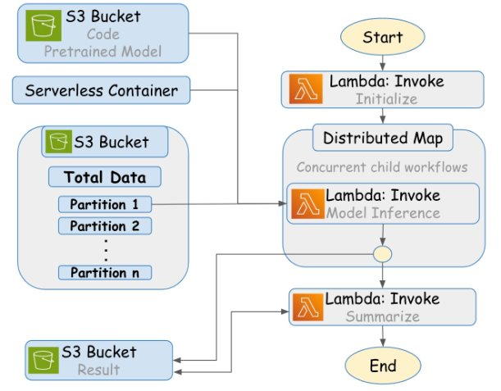
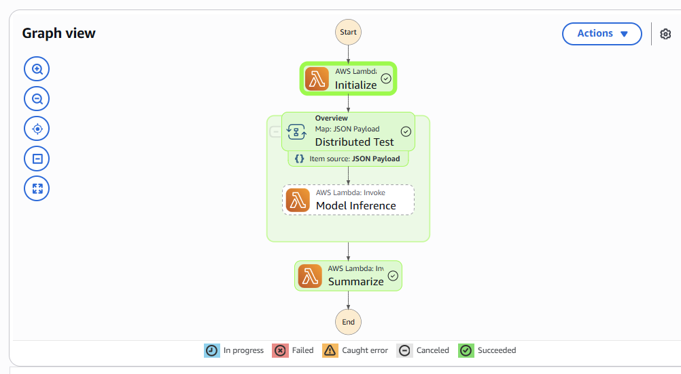
Pipeline steps
Step Function Design: Build scalable workflow for distributed inference
Partitioning: creating data partitions
Initialize: configuring payloads
Inference: Executes model and perms analysis on partitions
Summarize: Collects results into and exports to s3.

Slide 5
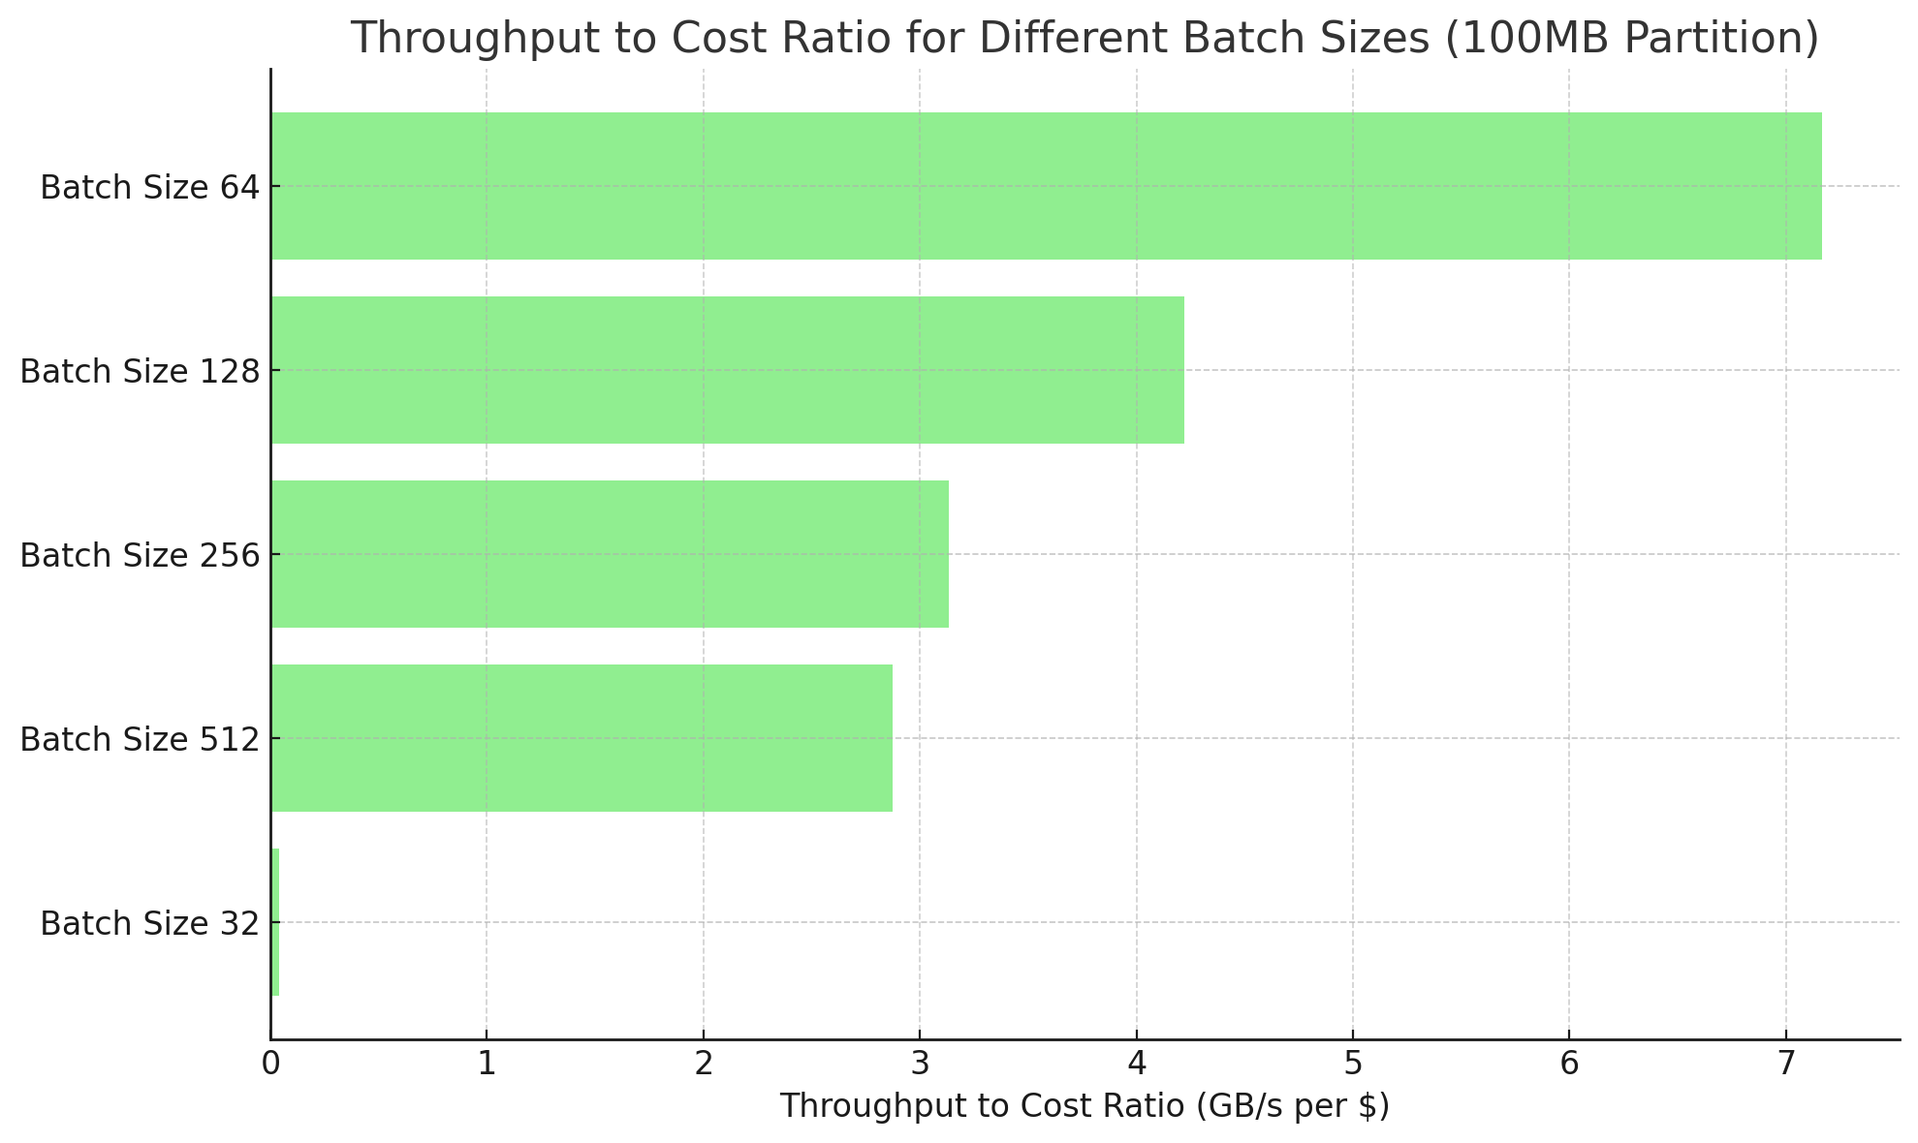
Batch Size experimentation
First, we wanted to perform test to determine the best batch size, so we ran 100 mb partitions for 0.10 gb of data and different batch sizes to find which gave the most throughput. We found that 256 provided us with the most throughput, but 64 provided us with the best throughput to cost ratio.
Partition (MB) | Lambda/File Limit | Avg Runtime (s) | Memory (MB) | Data Size (GB) | Cost ($) | Throughput (GB/s) | Batch Size | Total Execution Time (s) | Performance Efficiency (GB/s)/$
Different Batch Sizes @ 100 MB Partion & 1 File Limit
100 | 1 | 225.48 | 2738.23 | 0.10 | 0.0101 | 0.0004 | 32 | 163.2 | 0.04
100 | 1 | 22.51 | 1681.7 | 0.10 | 0.0006 | 0.0043 | 64 | 65.9 | 7.04
100 | 1 | 25.76 | 2138.4 | 0.10 | 0.0009 | 0.0038 | 128 | 45.7 | 4.23
100 | 1 | 20.60 | 4361.4 | 0.10 | 0.0015 | 0.0047 | 256 | 29.3 | 3.24
100 | 1 | 21.34 | 4517.6 | 0.10 | 0.0016 | 0.0046 | 512 | 37.5 | 2.92

Slide 6
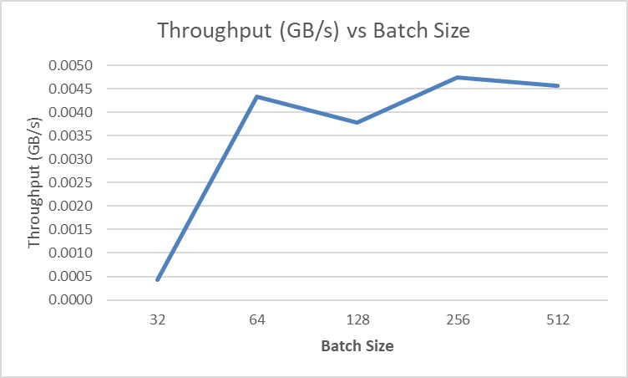
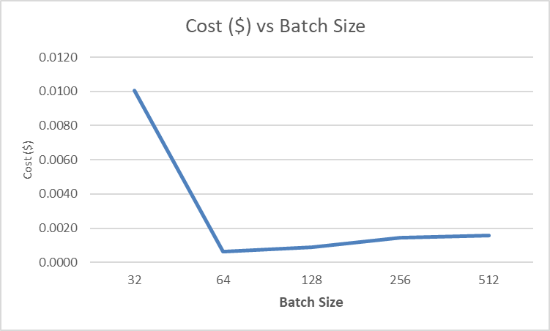
Batch size experimentation (cont)
Even though 64 provided the best throughput to cost ratio, we sticked with 256 since the difference in cost was small compared to the difference in throughput

Slide 7
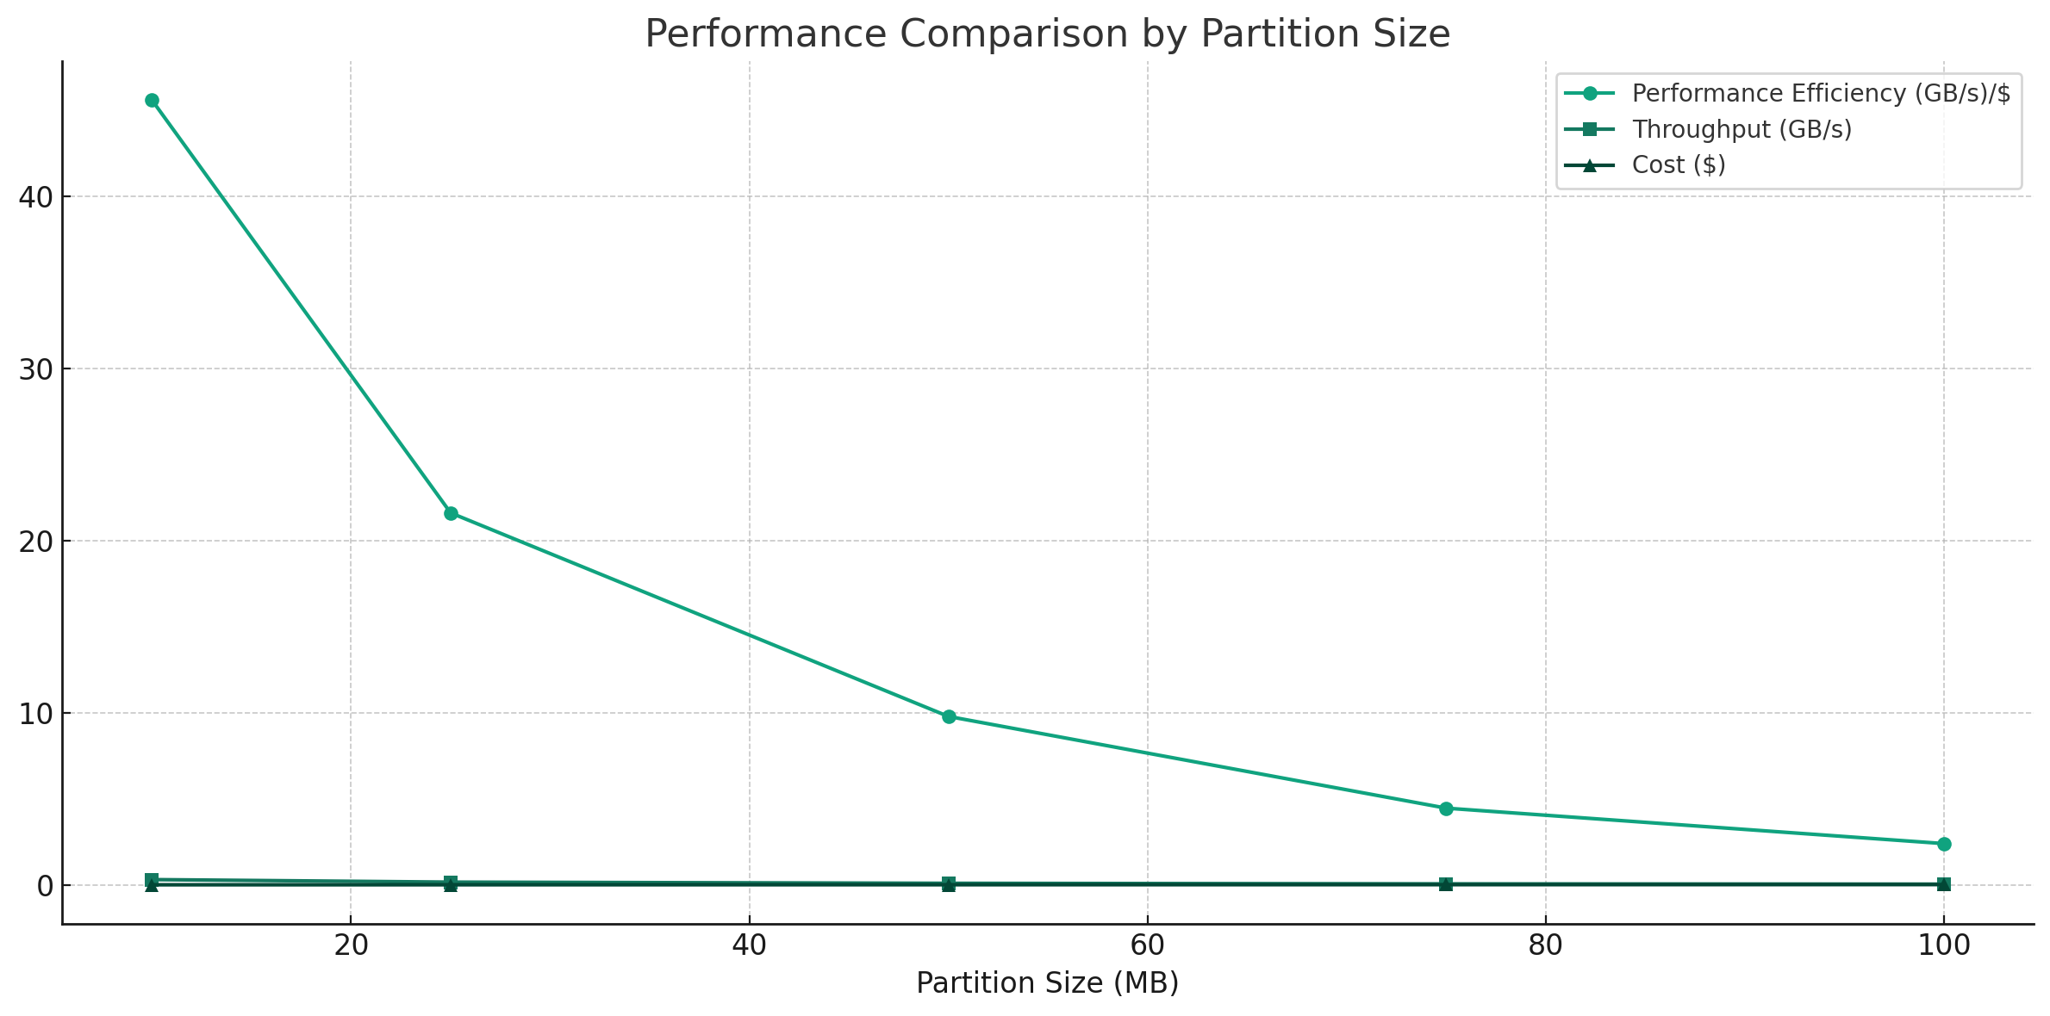
Best Partition size
For our pest partition experiments, we found that the 10 mb partitions size performed the best in terms of performance efficiency. This made us realize that as partition size increases, performance efficiency and throughput declines while cost increases.
This means lower partitions performed better
Partition (MB) | Lambda/File Limit | Avg Runtime (s) | Memory (MB) | Data Size (GB) | Cost ($) | Throughput (GB/s) | Batch Size | Total Execution Time (s) | Performance Efficiency (GB/s)/$
Different Partitions @ 1 gb Data Size
10 | 105 | 3.33 | 1186.8 | 1.03 | 0.0068 | 0.3080 | 256 | 28.4 | 45.61
25 | 42 | 6.35 | 1720.11 | 1.03 | 0.0075 | 0.1615 | 256 | 25.8 | 21.62
50 | 21 | 10.92 | 2570 | 1.03 | 0.0096 | 0.0939 | 256 | 26.7 | 9.79
75 | 14 | 17.05 | 3473 | 1.03 | 0.0135 | 0.0601 | 256 | 33.3 | 4.46
100 | 11 | 24.07 | 4314 | 1.07 | 0.0186 | 0.0446 | 256 | 39.7 | 2.40
Notes:
Pratham

Slide 8
Lambda Performance of 8gb and 12.6gb
Usually in real world examples, there is huge amount of data sizes that need to be processed. So, we want to experiment with half the dataset and the full dataset using the best partition size and batch size discovered in our previous experiments.
Partition (MB) | Lambda/File Limit | Avg Runtime (s) | Memory (MB) | Data Size (GB) | Cost ($) | Throughput (MB/s) | Batch Size | Performance Efficiency (GB/s)/$
25 | 516 | 6.4031 | 1782.9 | 12.6 | 0.0959 | 1.9674 | 256 | 0.04874454
25 | 327 | 7.103 | 1787.4 | 7.98 | 0.0676 | 1.124 | 256 | 0.06014235
Notes:
Pratham

Slide 9
Local vs Lambda vs Revana (GPU)
Given the advantages of using aws lambda, we compared the performance of three different environment to gauge effectiveness of saleable, parallel processing, aws lambda architecture.
Device | Data Size (GB) | Total Time (s) | Memory (MB) | Throughput (GB/s) | Batch Size
AWS Lambda | 6 | 6.38 | 1724.74 | 0.9419 | 256
Laptop | 6 | 2273.19 | 4228769.87 | 0.0185 | 256
Rivanna (gpu) | 6 | 96.50 | 6182329.36 | 0.4067 | 256
Notes:
Pratham

Slide 10
Conclusion
Cloud-native workflows are scalable, fast, and cost-effective
Proper tuning (batch, partition, file limits) is key
Local and GPU testing is useful for development, but AWS is better for scale
Best performance observed:
10 MB partition @ 4 GB: ~67 GB/s per dollar – 1.4482 throughput (GB/s) and $ 0.0216
Partition (MB) | Lambda/File Limit | Avg Runtime (s) | Memory (MB) | Data Size (GB) | Cost ($) | Throughput (GB/s) | Batch Size | Total Execution Time (s) | Performance Efficiency (GB/s)/$
Compare Best Result to 64 Batch Size
10 | 408 | 4.24 | 743.79 | 3.98 | 0.0210 | 0.9388 | 64 | 53.0 | 44.77
10 | 408 | 2.75 | 1180.918 | 3.98 | 0.0216 | 1.4482 | 256 | 41.8 | 67.11
Notes:
Dae

Slide 11
Significance and improvements
Possible improvements:
Utilizing GPU in our aws pipeline to perform faster processing
Optimizing model to better perform inference.
Significance:
These results can be very helpful for understanding the significance of data partitioning and how batch size can impact the performance and scalability of your infrastructure.

